Slide 1
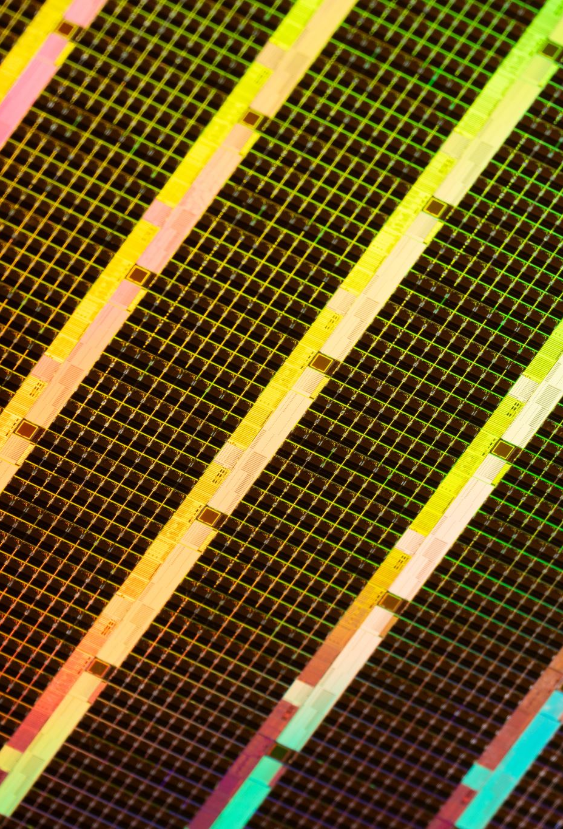
Ultrasonic Sensor-Based Radar System
Jean Carlos González López
Jean A. Miranda Vargas
ELEN-442 and ELEN-447
Prof. Daniel E. Mera Romo

Slide 2
Mission and Vision
Mission:
Create an ultrasonic sensor radar that allows us to see objects.
Vision:
Make what could possibly be a system used to evade obstacles.
1

Slide 3
Abstract
Design, implement, and test an ultrasonic sensor-based radar system.
Based on a reference Arduino design [3], with additional prototyping in Tinkercad.
Utilized an HC-SR04 ultrasonic sensor and SG90 servo motor to simulate a radar by scanning and measuring object distances.
Results show accurate distance measurement and a solid foundation for future improvements.
2

Slide 4
Introduction
Goal: To develop a functional radar system using an ultrasonic sensor and a servo motor.
Real-world relevance: Radars are used widely in aviation, robotics, and other fields.
Our project uses a simplified model using readily available components.
3

Slide 5
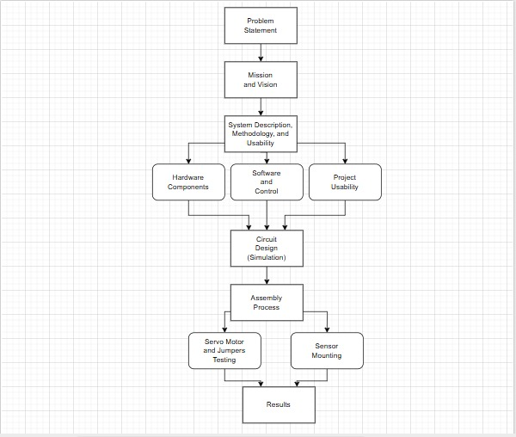
Project Flowchart
Figure 1: Projects Flowchart.
4

Slide 6
System Description, Methodology and Usability
5

Slide 7
Hardware Components
1. Ultrasonic Sensor: The ultrasonic sensor is used to measure distances by emitting sound pulses and calculating the time delay of the reflected waves.
2. Micro-Servo Motor: The micro-servo motor rotates the sensor across an angle of 180°, allowing the system to cover a range of directions.
3. Breadboard and Mounting Accessories: Breadboard facilitates easy prototyping, while zip ties and tape are used to secure the sensor to the servomotor and the assembly to the breadboard.
4. Microcontroller (Arduino): The Arduino board is used as the main microcontroller to drive the servomotor and to process the ultrasonic sensor’s readings.
6

Slide 8
Software and Control
The Arduino is programmed using Arduino IDE.
The code begins by testing the servo motor for accurate position control.
The readings from the ultrasonic sensor are taken while sweeping across angles.
The Arduino code handles the PWM signals and distance calculations.
Processing IDE is used to create a real-time radar interface for visualizing detected objects.
7

Slide 9
Project Usability
Ultrasonic sensors are used in various applications like container depth detection, home automation, and other fields.
For our project, it detects and highlights objects within its scanning range.
It is useful for detecting unseen obstacles – simulating a simplified military radar system.
The sensor emits ultrasonic waves, which reflect off objects and return to the sensor.
The distance is calculated using d = (340 m/s * t) / 2, where t is the time measured.
8

Slide 10
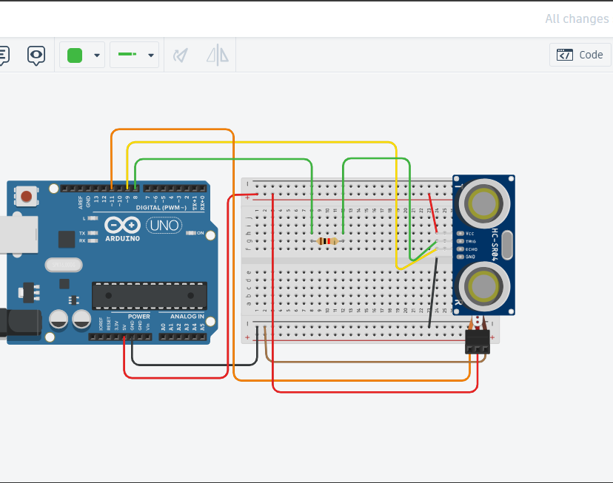
Circuit Design
The ultrasonic sensor is mounted on top of the micro-servo motor.
The final placement for the ultrasonic sensor and servo motor was determined during project development.
In the simulation, both components functioned as intended.
Tinkercad warned us that connecting TRIG directly to the Arduino could cause damage, so we added a resistor of 1KΩ, and it resolved the issue, ensuring safe operation.
Figure 2: Circuit Design in Tinkercad.
9

Slide 11
#include<Servo.h>
#define trigPin 8
#define echoPin 9
long duration;
int distance ;
Servo myservo;
int calculateDistance()
{
digitalWrite(trigPin,LOW);
delayMicroseconds(2);
digitalWrite(trigPin,HIGH);
delayMicroseconds(10);
digitalWrite(trigPin,LOW);
duration = pulseIn(echoPin, HIGH);
distance = duration*0.034/2;
return distance;
}
void setup()
{
pinMode(trigPin , OUTPUT);
pinMode(echoPin, INPUT);
myservo.attach(11);
Serial.begin(9600);
}
void loop()
{
int i ;
for (i=15; i<=165; i++)
{
myservo.write(i);
delay(15);
calculateDistance();
Serial.print(i);
Serial.print(",");
Serial.print(distance);
Serial.print(".");
}
for(i=165; i>=15; i--)
{
myservo.write(i);
delay(15);
calculateDistance();
Serial.print(i);
Serial.print(",");
Serial.print(distance);
Serial.print(".");
}
}
Circuit Design Code
Figure 3: Simulation Code.
10

Slide 12
Power Analysis
Component | Power Consumption (Watts)
Arduino Uno | 1.04W
HC-SR04 Ultrasonic Sensor | 75mW
SG90 Servo Motor | 1.25W
Total Power Consumption | 2.365W
Figure 4: Power Analysis Table
We conducted a power analysis of how many watts our system would use, and we concluded that the total wattage of the system is 2.365W.
Our system uses very few components of low cost and low power consumption, thus making our radar system efficient.
11

Slide 13
Component Costs
Components | Cost
Arduino Uno | $20 to $30
Servo Motor | $6.99
Breadboard | $6.99 to $7.99
Zip Ties and Double-Sided Tape | $13.21 (for a bag of 88 zip ties) $7.48 (for the double-sided tape)
Ultrasonic Sensor | $7.99
Total Cost | $73.66
Figure 5: Component Cost Table.
Afterwards we conducted a cost analysis of all the components that were used for our system.
The system uses a small number of components making it relatively cheap.
12

Slide 14
Assembly Process
13

Slide 15
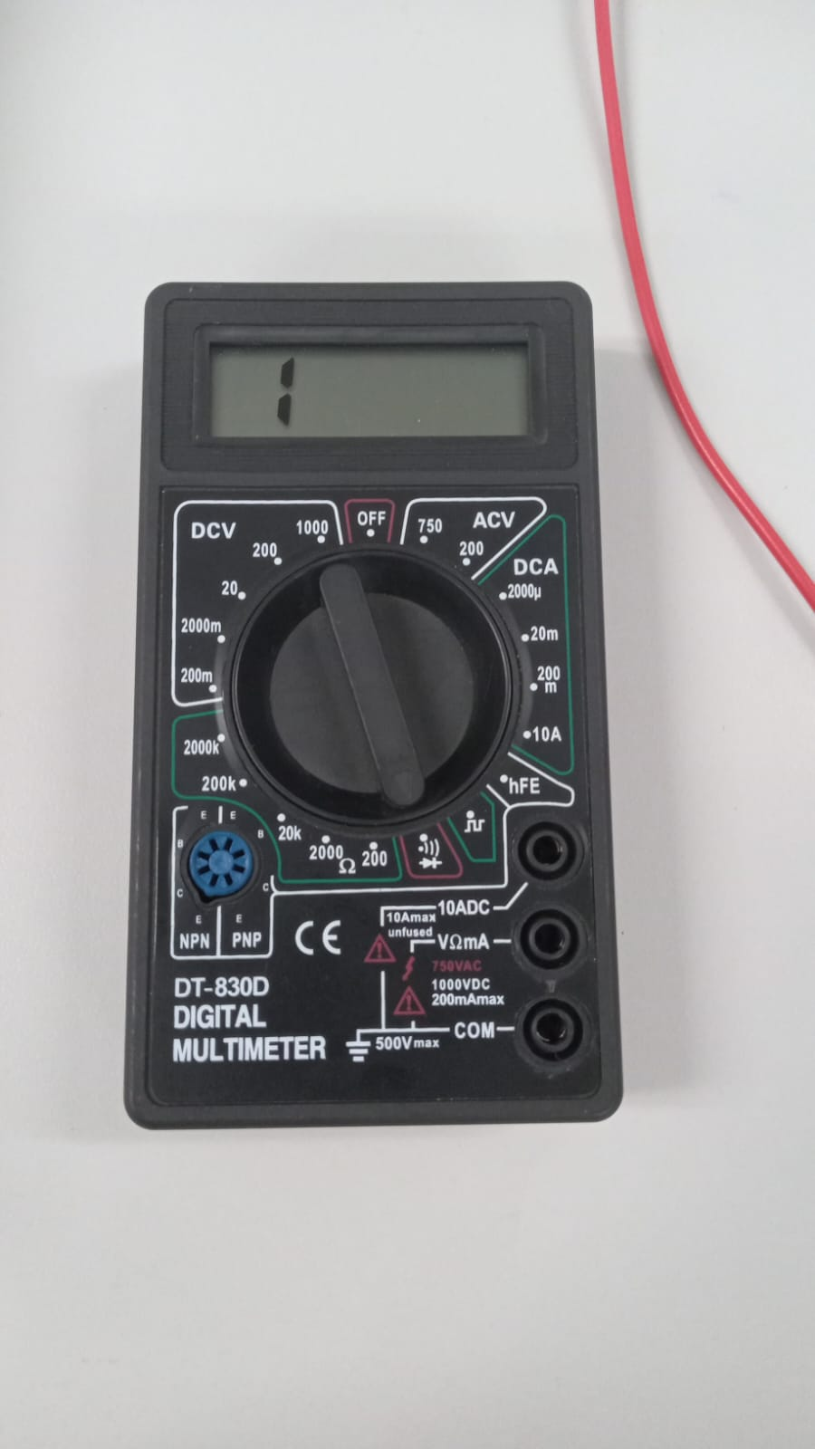
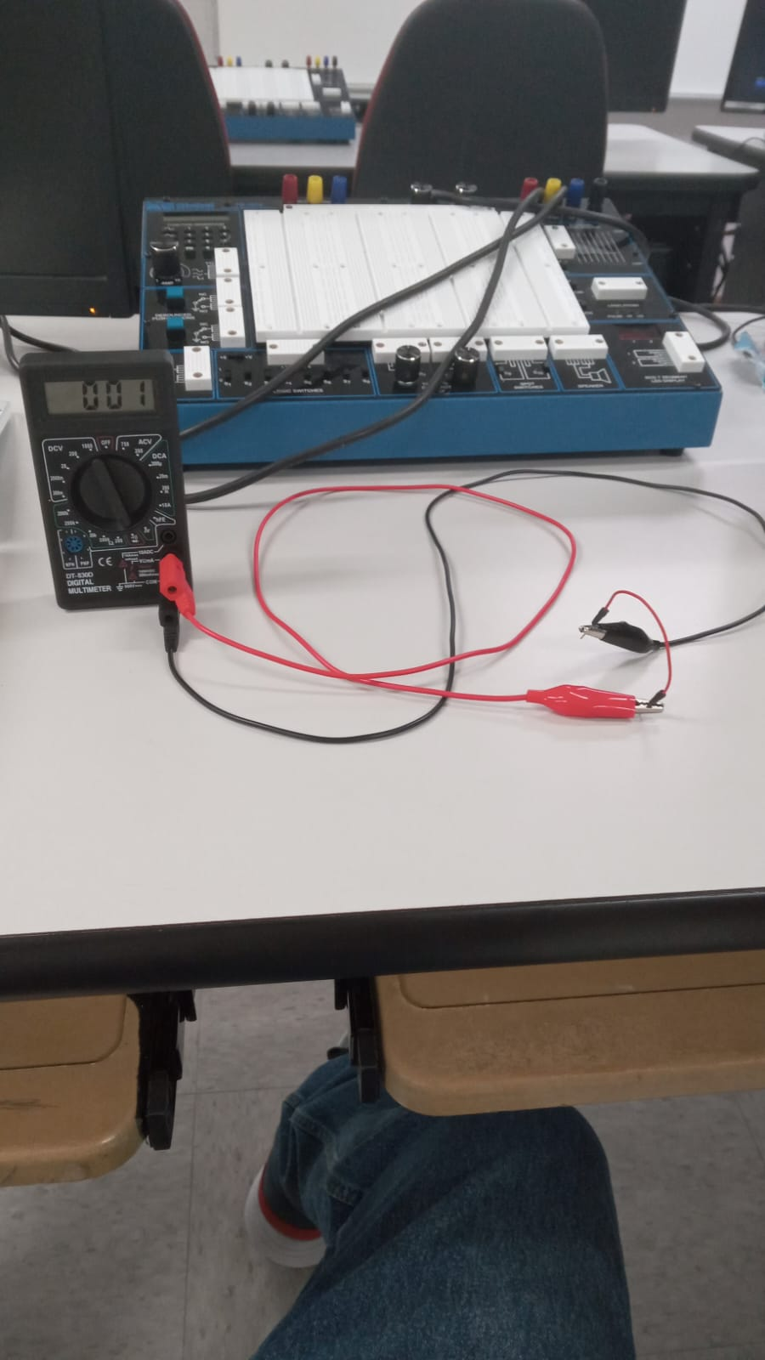
Servo Motor Testing
We began the assembly process by testing the jumper wires and the micro-servo motor.
Arduino kits sometimes include faulty equipment – especially jumpers and servo motors.
Testing ensured the motor spun as expected for radar scanning.
We verified jumper wire integrity using a multimeter.
Figure 7: Jumper Wire Testing.
Figure 6: Multimeter Used.
14

Slide 16
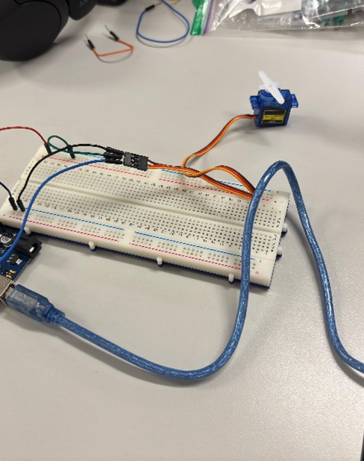
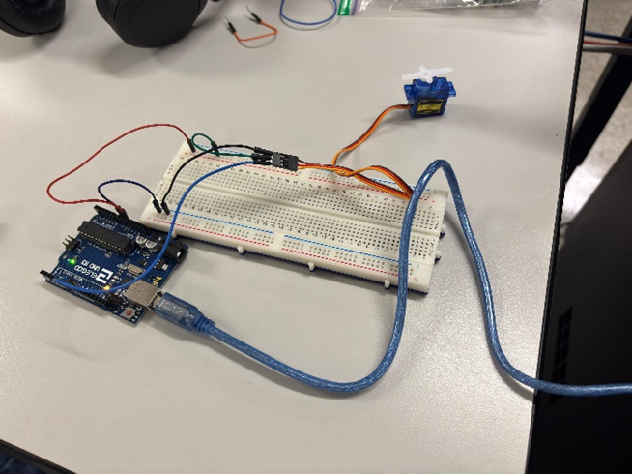
Figure 9: Servo Motor Spinning.
Figure 8: Testing Servo Motor.
15

Slide 17
#include <Servo.h>
Servo myServo;
void setup() {
myServo.attach(9); // signal pin on D9
}
void loop() {
// Fast sweep from 0 to 180
for (int pos = 0; pos <= 180; pos += 5) {
myServo.write(pos);
delay(5); // faster motion
}
// Fast sweep from 180 to 0
for (int pos = 180; pos >= 0; pos -= 5) {
myServo.write(pos);
delay(5);
}
}
Figure 10: Code Used to Test Micro-Servo Functionality.
The servo motor was programmed to rotate through a series of angles. The motor spun accurately, and we determined that it was working properly after we finished the testing.
16

Slide 18
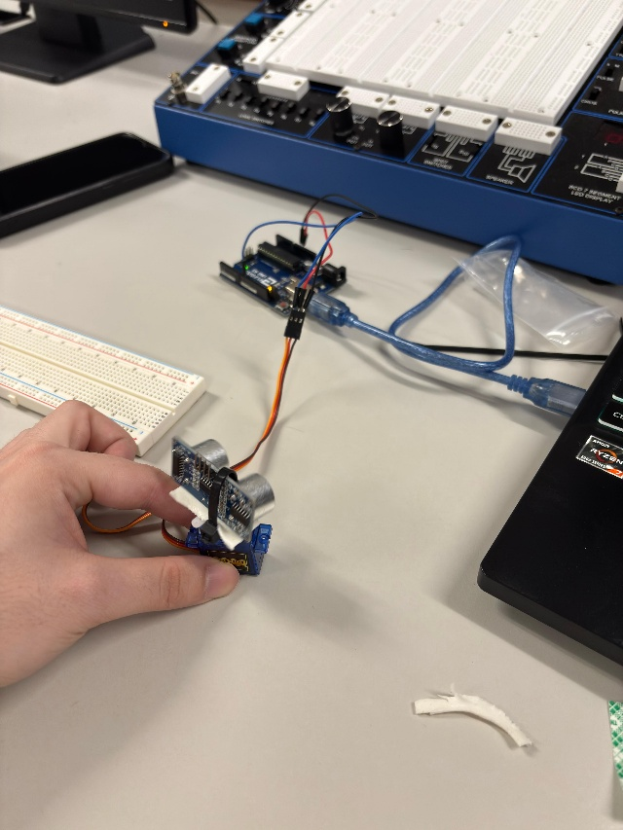
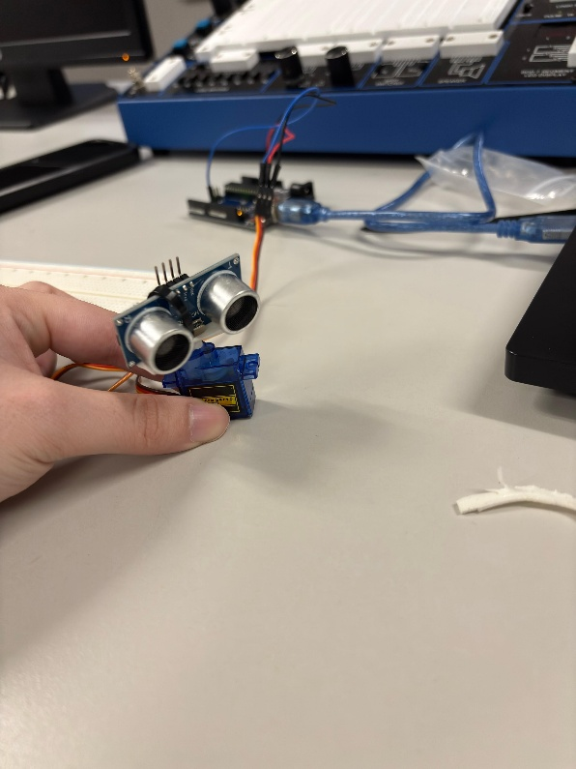
Sensor Mounting
After testing the servo motor, we focused on mounting the ultrasonic sensor.
We attached the ultrasonic sensor on top of the servo motor secured with zip ties fastened to both.
We performed the same servo motor tests with the same code in Figure 10 to confirm that the sensor was securely mounted during operation.
Figure 11: Ultrasonic Sensor Mounted to Servo Motor.
Figure 12: Servo Motor Spinning with Sensor Mounted.
17

Slide 19
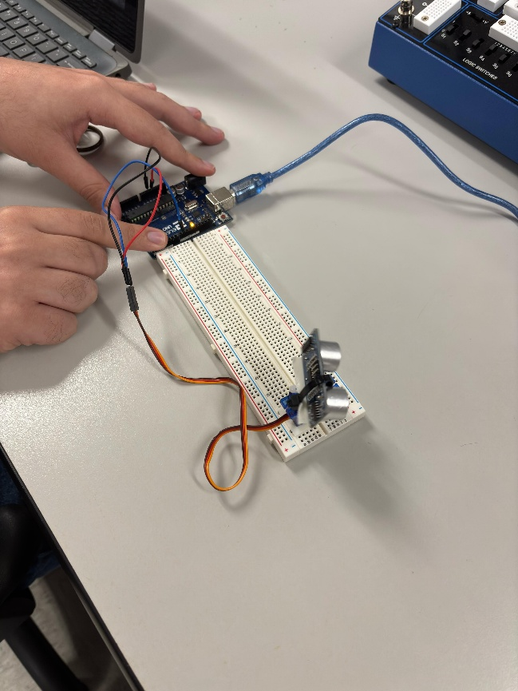
We then proceeded to mount the servo motor to the breadboard using double sided tape for stability.
We ran the same tests as before to ensure proper rotation.
We confirmed that the setup was secure and functional.
We proceeded to wire the sensor to the Arduino.
Figure 13: Servo Motor Secured to Breadboard.
18

Slide 20
Wiring Process
We wired the entire circuit and fully integrated all of the components:
Power Rails: We connected a cable from the Arduino 5V VCC to the breadboards positive rail. A cable was also connected to the Arduinos GND and was connected to the negative rail on the breadboard.
Ultrasonic Sensor: The ultrasonic sensor was wired in the following manner. The VCC on the sensor was connected to the breadboards positive rail with a cable, the GND was connected to the negative rail on the breadboard. The TRIG from the sensor was connected with a cable to the Arduino’s digital pin D2 through a 1KΩ resistor to limit current and to protect it. Finally, the ECHO was connected with a cable to Arduino’s digital pin D3.
Micro Servo Motor (SG90): The micro servo motor was connected in the following manner. The VCC (red) was connected to the breadboards positive rail, the GND (brown) was connected to the breadboards negative rail, finally the SIGNAL (orange) was connected to the Arduino’s digital pin D4.
19

Slide 21
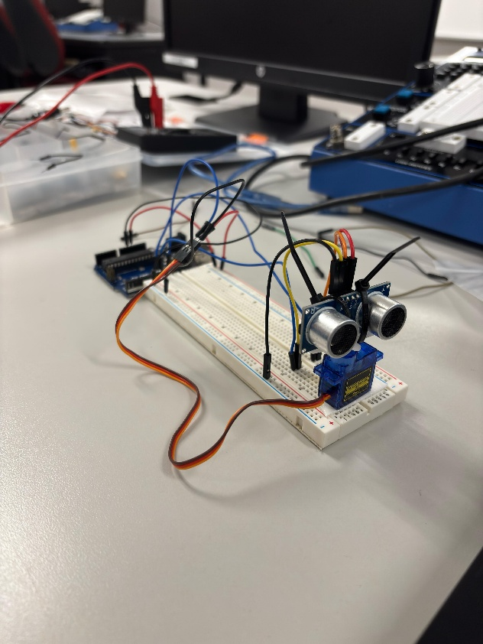
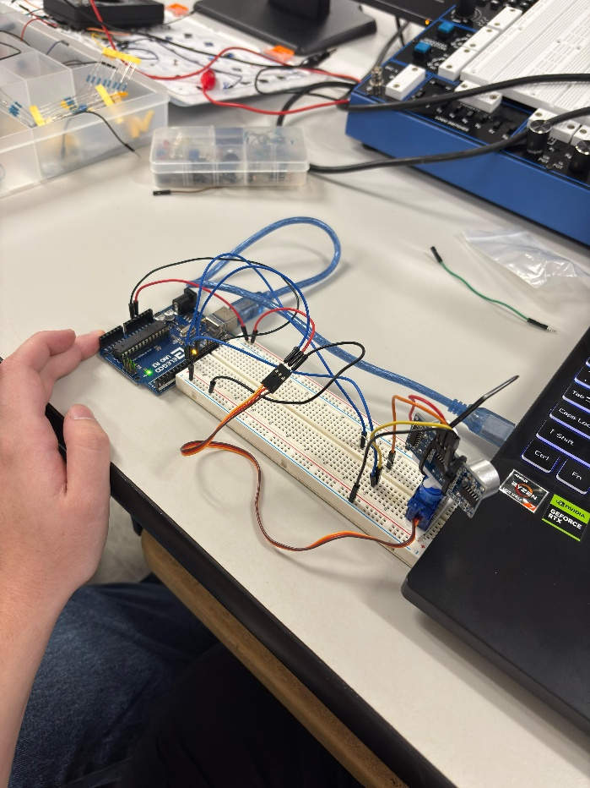
Figure 14: Circuit Fully Wired.
Figure 15: Circuit Functioning.
20

Slide 22
Code for Arduino, Ultrasonic Sensor, and Micro Servo Motor.
/**
* Ultrasonic Radar with Servo Sweep
*
* This sketch controls an HC-SR04 ultrasonic sensor mounted on a servo motor.
* It performs a continuous 0°→180°→0° sweep, measures distance at each angle,
* and sends “angle,distance.” strings over Serial for visualization.
*
* Connections:
* - trigPin (D2) → HC‑SR04 Trig (with 1K Ω series resistor)
* - echoPin (D3) → HC‑SR04 Echo
* - servo signal → Servo signal line on D4
* - 5 V and GND → common power/ground rails
*/
#include <Servo.h> // Include Servo library for PWM control
// Pin definitions
#define trigPin 2 // Ultrasonic sensor trigger pin
#define echoPin 3 // Ultrasonic sensor echo pin
// Variables for distance calculation
long duration; // Time (µs) for echo return
int distance; // Calculated distance in cm
Servo myservo; // Servo object for controlling the sweep
/**
* calculateDistance()
*
* Sends a 10 µs pulse on trigPin, measures the time until echoPin goes HIGH,
* converts that duration into a distance (cm), and returns it.
*/
int calculateDistance() {
// Ensure trigger is LOW for at least 2 µs
digitalWrite(trigPin, LOW);
delayMicroseconds(2);
// Send a 10 µs HIGH pulse to trigger ultrasonic burst
digitalWrite(trigPin, HIGH);
delayMicroseconds(10);
digitalWrite(trigPin, LOW);
// Read the duration of the HIGH pulse on echoPin
duration = pulseIn(echoPin, HIGH);
// Convert time (µs) to distance (cm): sound speed ≈ 0.034 cm/µs, divide by 2 for round trip
distance = duration * 0.034 / 2;
return distance;
}
void setup() {
// Configure sensor pins
pinMode(trigPin, OUTPUT);
pinMode(echoPin, INPUT);
// Attach servo to pin 4
myservo.attach(4);
// Begin serial output for Processing visualization (9600 baud)
Serial.begin(9600);
}
void loop() {
// --- Sweep from 0° to 180° ---
for (int pos = 0; pos <= 180; pos += 5) {
myservo.write(pos); // Move servo to current angle
delay(30); // Short delay for smooth movement
calculateDistance(); // Update `distance`
// Send formatted data: "angle,distance."
Serial.print(pos);
Serial.print(",");
Serial.print(distance);
Serial.print(".");
}
// --- Sweep from 180° back to 0° ---
for (int pos = 180; pos >= 0; pos -= 5) {
myservo.write(pos);
delay(30);
calculateDistance();
Serial.print(pos);
Serial.print(",");
Serial.print(distance);
Serial.print(".");
}
}
After we finished wiring the entire circuit, we then proceeded to write the code for the Arduino to work with the ultrasonic sensor and to work in conjunction with the servo motor.
21
Figure 16: Arduino Code.

Slide 23
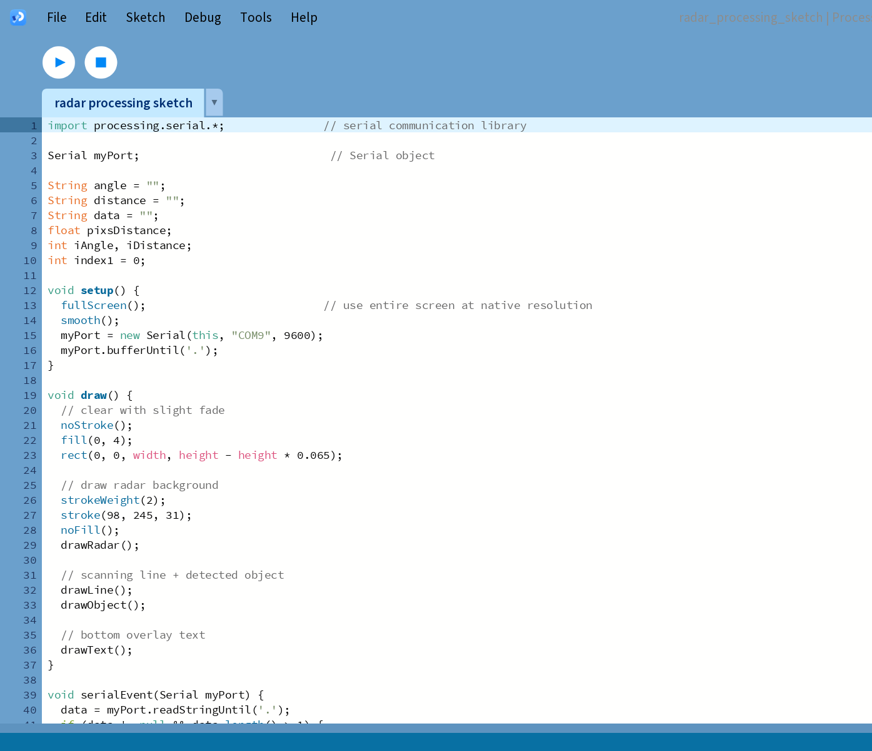
Processing IDE Code
Once the Arduino code was completed, we proceeded to edit the Processing IDE code in the radar reference project [3]. This code and software will allow us to display a radar matrix on the computer to physically view the radar in action.
Figure 17: Processing IDE Code Overview.
22

Slide 24
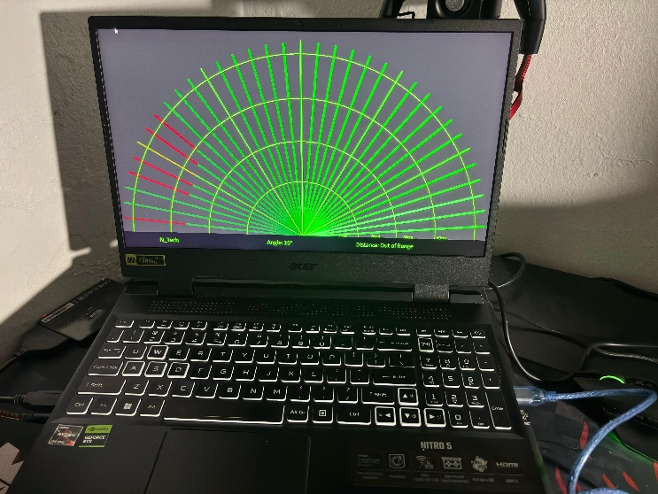
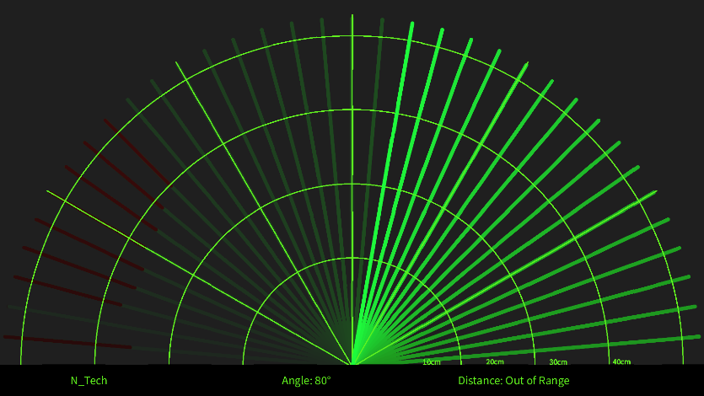
Results
After the codes and circuit were completed, we deployed the Arduino code and Processing code.
Upon startup, the servo motor began a smooth 0 to 180 degree sweeping motion.
The ultrasonic senor emitted pulses and measured the distances.
Sensor readings were sent via Serial to the Processing sketch in real-time.
Processing IDE launched a full-screen radar interface with arcs and spokes.
The green sweep line matched the servo movement; red blips appeared for nearby objects.
Figure 18: Radar Interface Working.
Figure 19: Radar Interface.
23

Slide 25
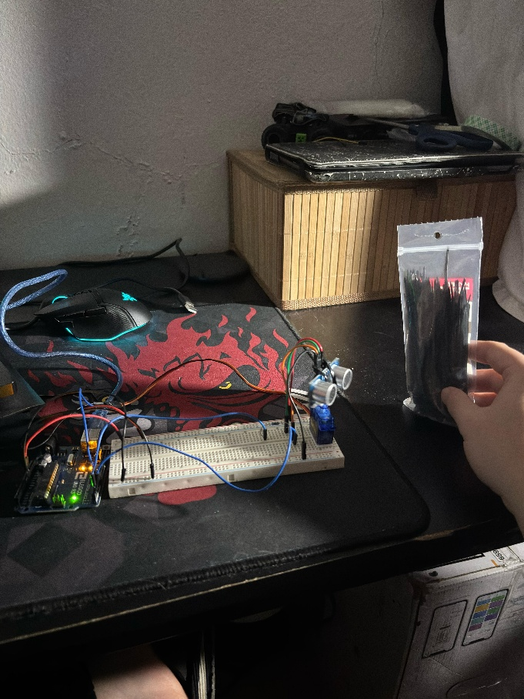
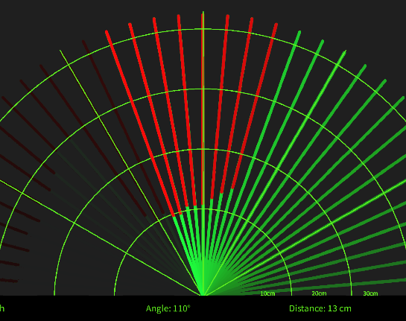
We tested the system with various objects at different positions.
The radar accurately detected object presence and distance in real time.
System performance was consistent and reliable throughout testing.
The radars behavior closely resembled the scanning and display of a military radar.
Figure 21: Radar Interface Showing Object.
Figure 20: Object In Front of Sensor.
24

Slide 26
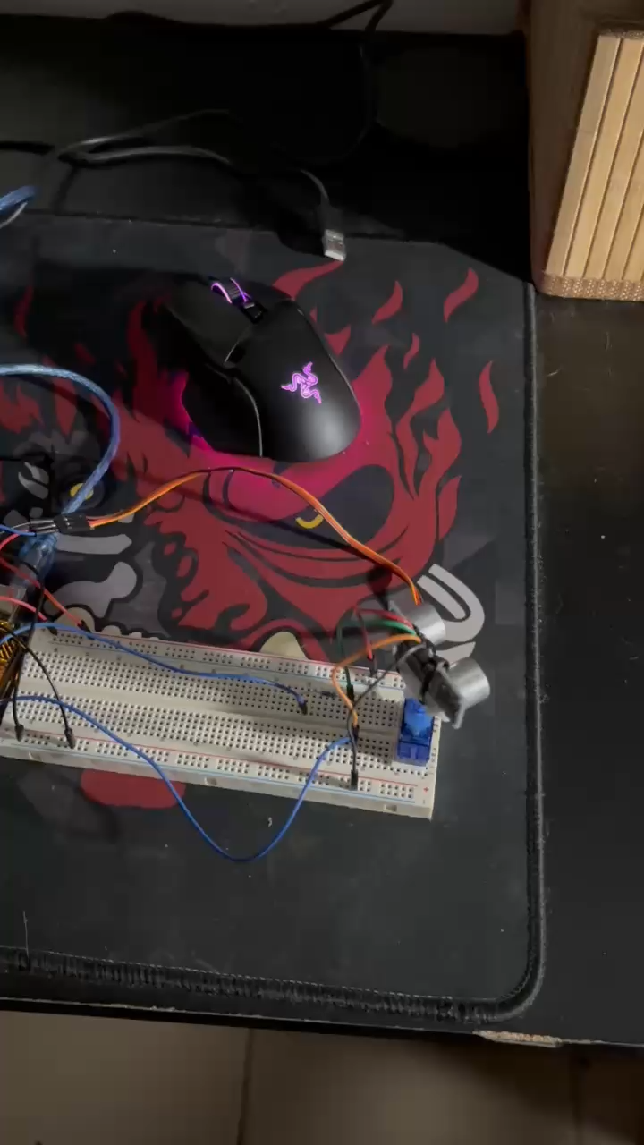
Video Demonstration
Figure 22: Circuit Video Demonstration.
25

Slide 27
Conclusion
In conclusion, we successfully built a radar system using low-cost components (HC-SR04 Sensor, SG90 Servo Motor, Arduino Uno).
All stages of development – from circuit design to visualization – functioned reliably and cohesively.
The Arduino efficiently managed servo movement and real-time distance calculations.
Processing IDE delivered smooth, real-time radar visualizations of detected objects.
Our results showed minimal error and consistent servo sweep pattern.
Tinkercad simulation ensured circuit reliability before physical setup.
Future improvements could include: extended sensor range, buzzer to simulate an alarm after object detection, wireless data transmission.
26

Slide 28
References
[1] Bay Alarm Company, “How Do Motion Sensors Work? A Guide,” Bay Alarm Blog. [Online]. Available: https://www-bayalarm-com.translate.goog/blog/how-do-motion-sensors-work-a-guide/?_x_tr_sl=en&_x_tr_tl=es&_x_tr_hl=es&_x_tr_pto=sge#:~:text=Active%20ultrasonic%20sensors%20emit%20ultrasonic,pulse%20and%20receives%20the%20echo. [Accessed: April. 2025].
[2] Servicios a la Navegación en el Espacio Aéreo Mexicano, “Sistema de Radar,” Gobierno de México. [Online]. Available: https://www.gob.mx/seneam/articulos/sistema-de-radar. [Accessed: April. 2025].
[3] N. Mishra, “Ultrasonic Radar with Arduino,” Arduino Project Hub. [Online]. Available: https://projecthub.arduino.cc/nimishac/ultrasonic-radar-with-arduino-19baa3. [Accessed: April. 2025].
27

